Slide 1
FEM2401
Malaysian Politics and Society
INTRODUCTION CLASS: GET TO KNOW MALAYSIA

Slide 2
Learning outcome:
● To understand an overview of Malaysia
● To describe the general knowledge and facts about Malaysia

Slide 3
“What do you know about Malaysia?”
What are the colors of Malaysian’s flag?
What is the main ethnics’ group in Malaysia?
How many political system that Malaysia has?
How many states that Malaysia has?
5What is the name of current Prime Minister of Malaysia?
Does Malaysia has a king system?
What is the other name of Malaysia’s flag?
Who is the Malaysia’s first Prime Minister?
When is Malaysia’s Independence Day?
What is Malaysia’s official language?
Who is the Malaysia’s head of country?
What is the Malaysia’s political system?

Slide 4
“What do you know about Malaysia?”
● Capital city of Malaysia?
● Center of administration?
● Who is the highest leader in Malaysia?
● The majority ethnic group?
● The national flower?
● How many states?
● The political system?

Slide 5
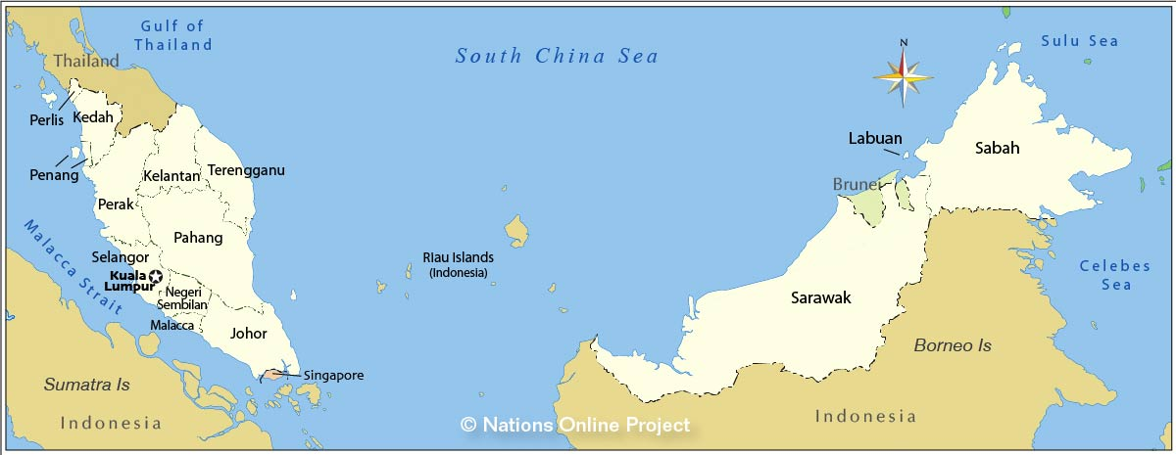
Malaysia

Slide 6
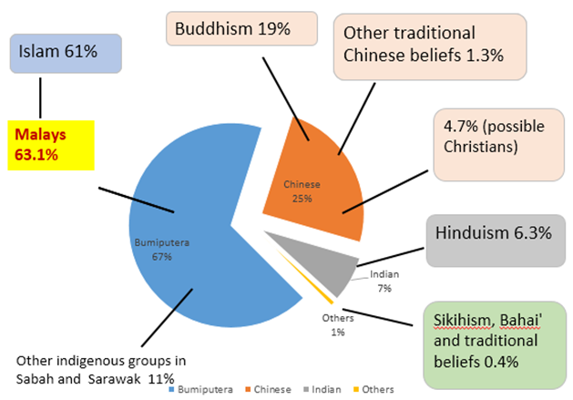
MALAYSIA
Heart of Southeast Asia
Multi-ethnic, multi-cultural, multi-religious multi-lingual society – a miniature of Asia
3 main ethnic groups ; Malay, Chinese and India
More than 60 sub-ethnic groups
MULTI-ETHNIC, MULTI-LINGUAL & MULTI-RELIGIOUS SOCIETY

Slide 7
STATES AND TERRITORIES IN MALAYSIA
STATES:
Perlis
Kedah
Pulau Pinang
Perak
Selangor
Negeri Sembilan
Melaka
Johor
Pahang
Terengganu
Kelantan
Sarawak
Sabah
Federal Territories (FT):
FT Kuala Lumpur
FT Putrajaya
FT Labuan

Slide 8
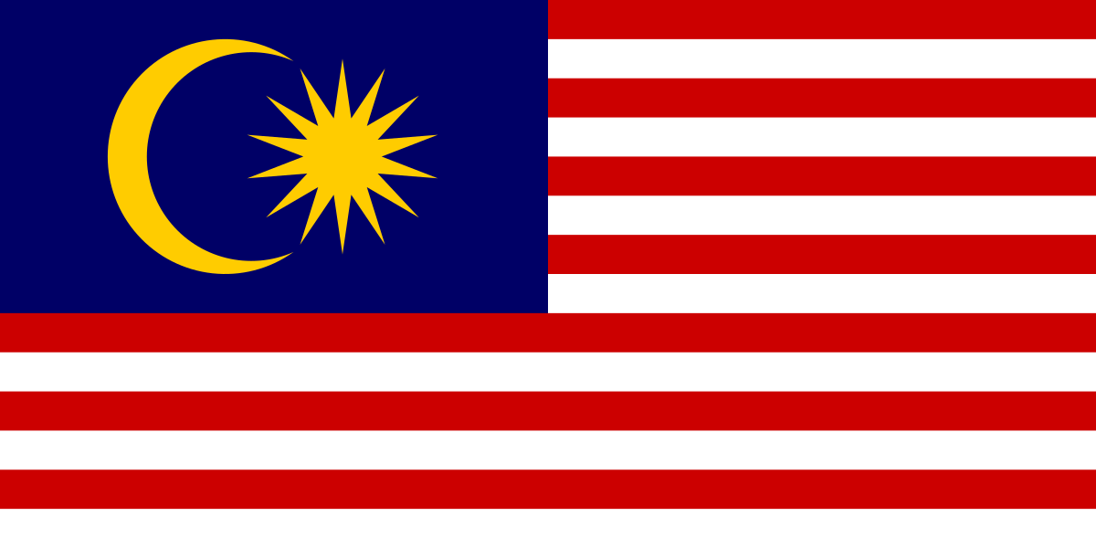
FLAG OF Malaysia

Slide 9
MALAYSIAN FLAG (Bendera Malaysia)
Known as the Jalur Gemilang (Stripes of Glory)
Symbol of leadership, dignity, identity, and national sovereignty.
Colour meaning: yellow (royalty), red (bravery), white (purity), blue (unity), red-blue stripes (traditional colours of the Malay region)
Symbol meaning: sun and moon (Islam), fourteen-pointed star (unity of the 14 states and territories), fourteen red-white stripes (14 states and Federal Territories)

Slide 10
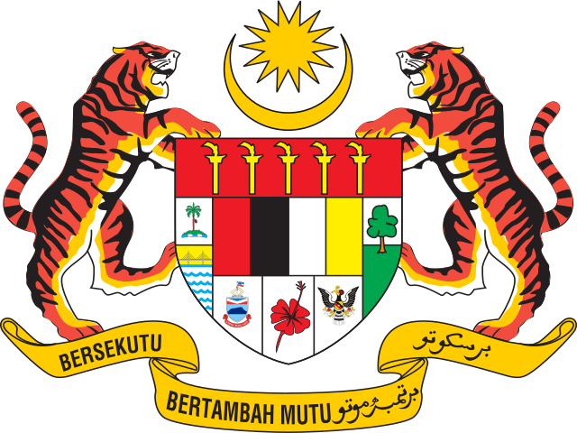
NATIONAL COAT OF ARMS

Slide 11
POLITICAL SYSTEM
A federation system
Constitutional monarchy
Parliamentary democracy

Slide 12
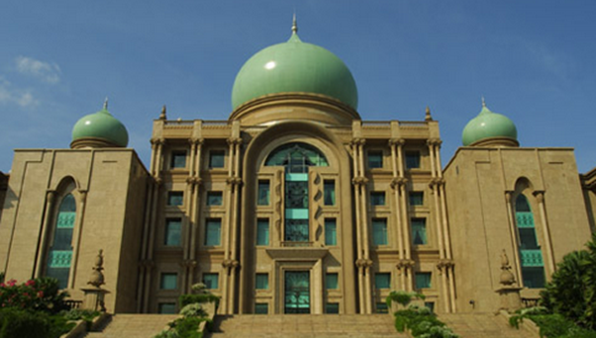
FEDERALISM IN MALAYSIA
Federal – state relations
Distribution of legislative and executive powers – based on the Constitution
Sabah and Sarawak – special provisions
Federal government is SUPREME than state government

Slide 13
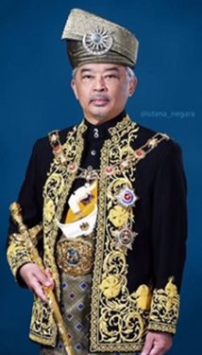
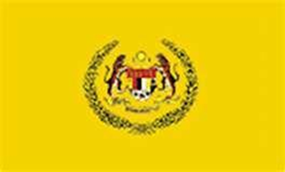
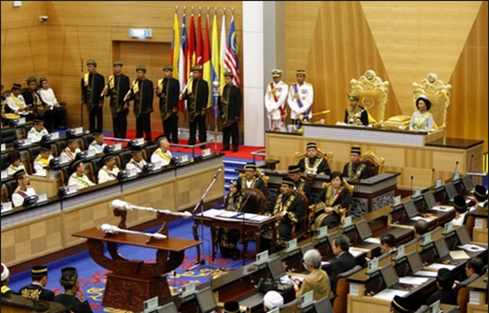
CONSTITUTIONAL MONARCHY
Malays sultanates/rulers
tradition position
Head of nine states
Power/Duty as provided by Constitution
Yang di-Pertuan Agong
Supreme Ruler
Head of Federation/State
Head of Executive, Legislative and Judiciary
Conference of Rulers

Slide 14
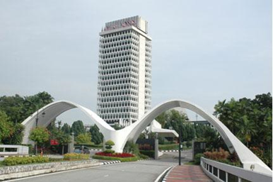
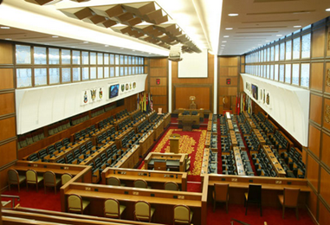










PARLIAMENTARY DEMOCRACY
Representative democracy
Election system
General election every five years
Parliament
House of representatives
Senate
Political party system – multi party
More than 30 political parties registered

Slide 15
POWER SHARING
Formula for managing ethnic diversity
Political coalition : every major ethnic group is represented in the Cabinet
Political party = ethnic based
61 years : Ruled by Barisan Nasional (National Coalition/BN) - Coalition of 13 political parties
Currently : Unity Government: Pakatan Harapan (The Alliance of Hope) with Barisan Nasional (National Coalition/BN) rule the country since November 2022.

Slide 16
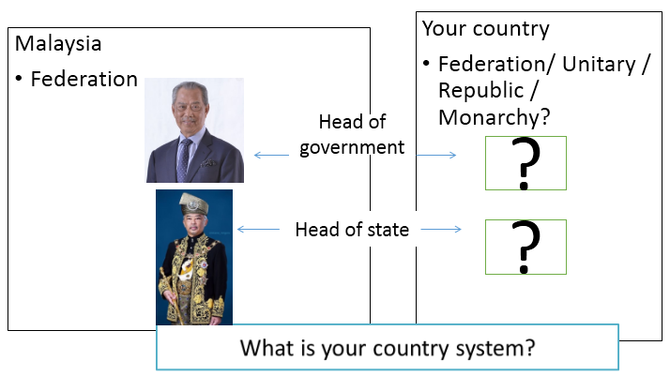
MALAYSIA AND YOUR COUNTRY: A COMPARISON

Slide 17
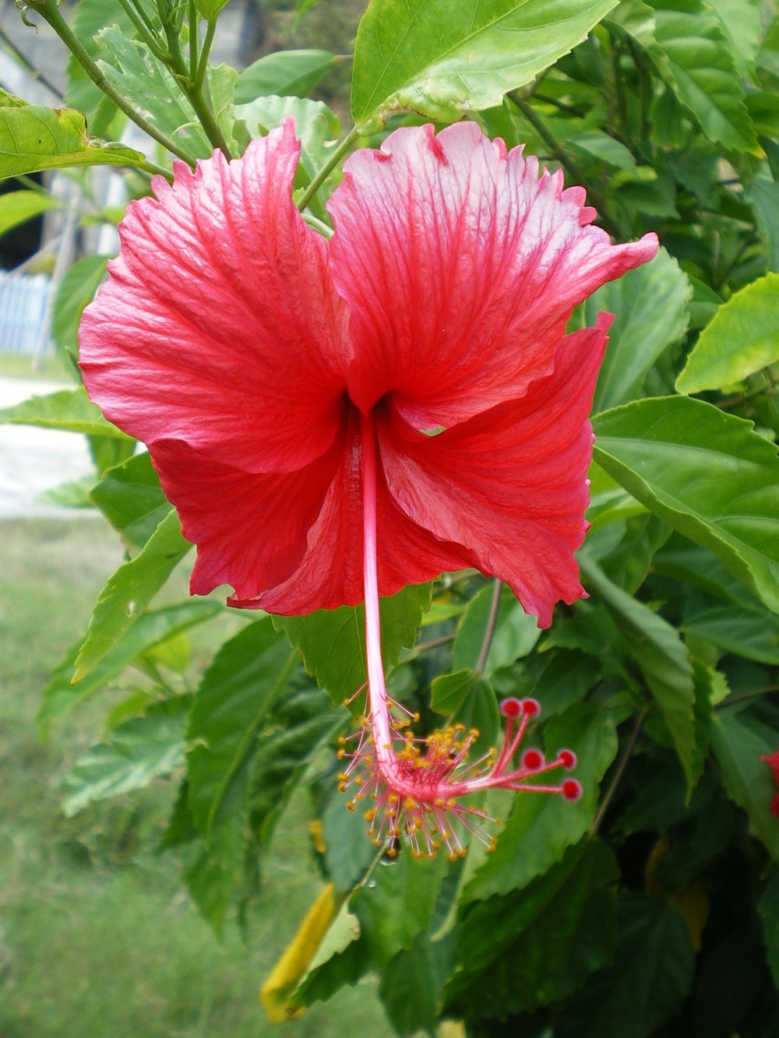
NATIONAL FLOWER
Common name: Hibiscus, Chinese-rose
Scientific name: hibiscus rosa-sinensis
Symbol: bravery and spirit of the people; five petals symbolize the five principles of the Rukun Negara

Slide 18
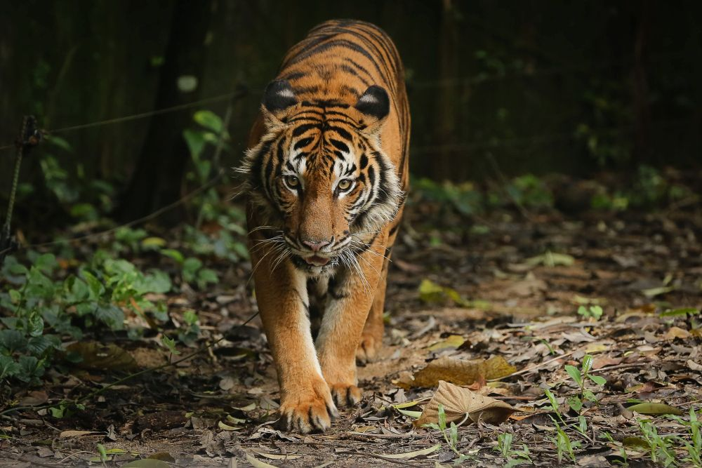
National Animal
Nama: Malayan Tiger
Scientific name: Panthera tigris tigris
Status: critically endangered
Symbol: depicted in national and state institutions, such as the Coat of Arms of Malaysia, Johor, Kuala Lumpur, Football Association of Malaysia, Royal Malaysian Police, etc.

Slide 19
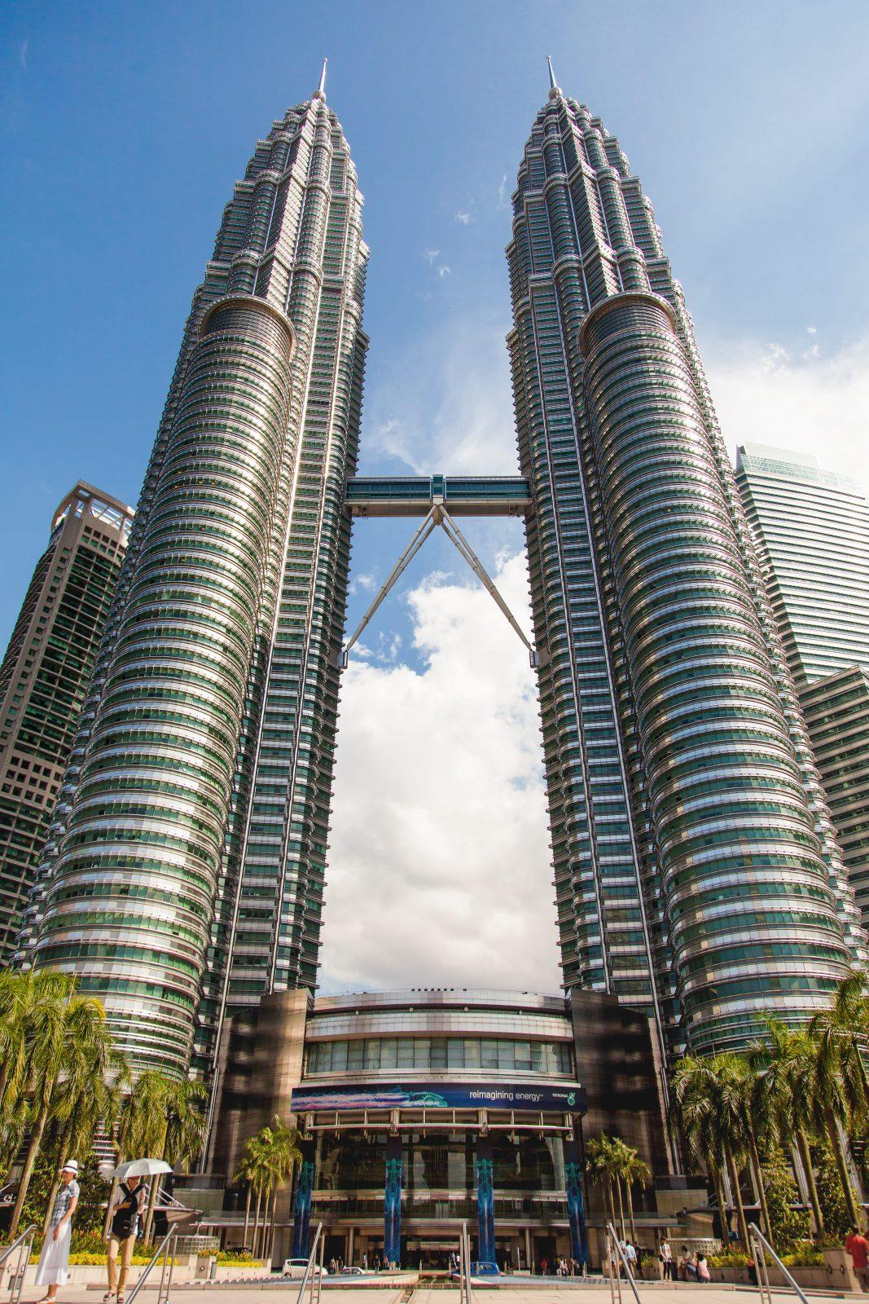
Kuala Lumpur
Federal Territory of Kuala Lumpur
Capital City of Malaysia
Founded in the mid-19th century; capital of the Federated Malay States, later the Federation of Malaya and Malaysia
In 1999, the seat of government moved to Putrajaya, but KL remains as capital
Head: Mayor
Famous song about Kuala Lumpur: Alleycats, Senyumlah Kuala Lumpur
https://www.youtube.com/watch?v=SoitvitmW04
Petronas Twin Towers

Slide 20
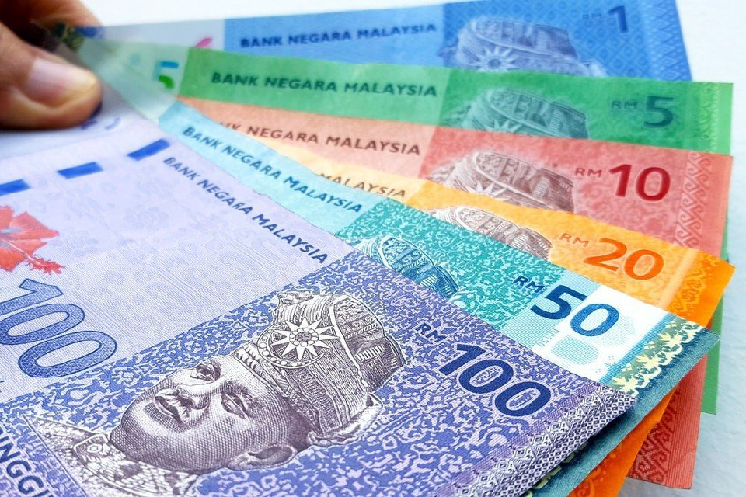
Currency
Currency: Ringgit
Symbol: RM
Denomination:
Coins: 5 sen, 10 sen (kupang), 20 sen, 50 sen
Banknotes: RM1, RM5, RM10, RM50, RM100

Slide 21
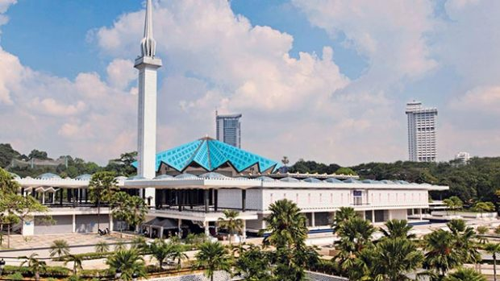
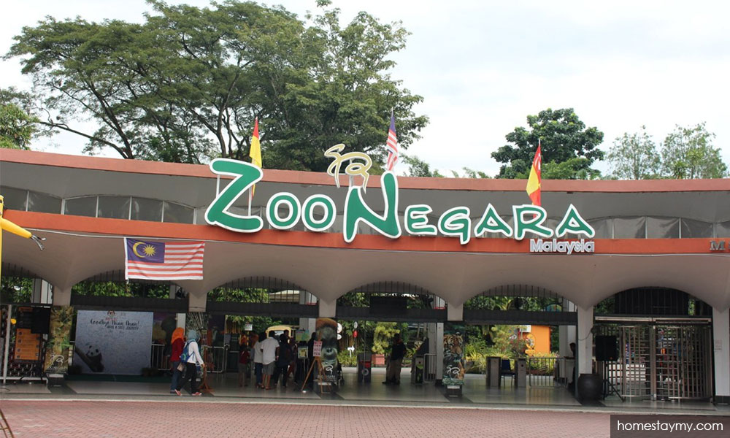
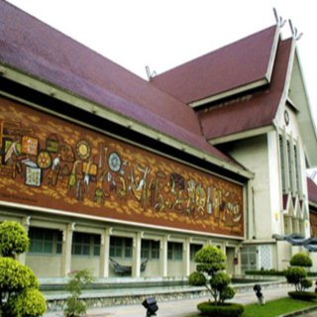
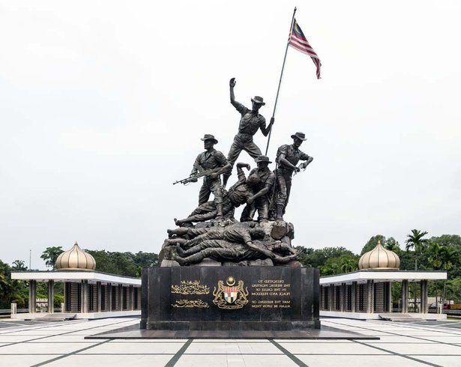
NATIONAL LANDMARKS
National Mosque
National Zoo
National Monument
National Museum

Slide 22
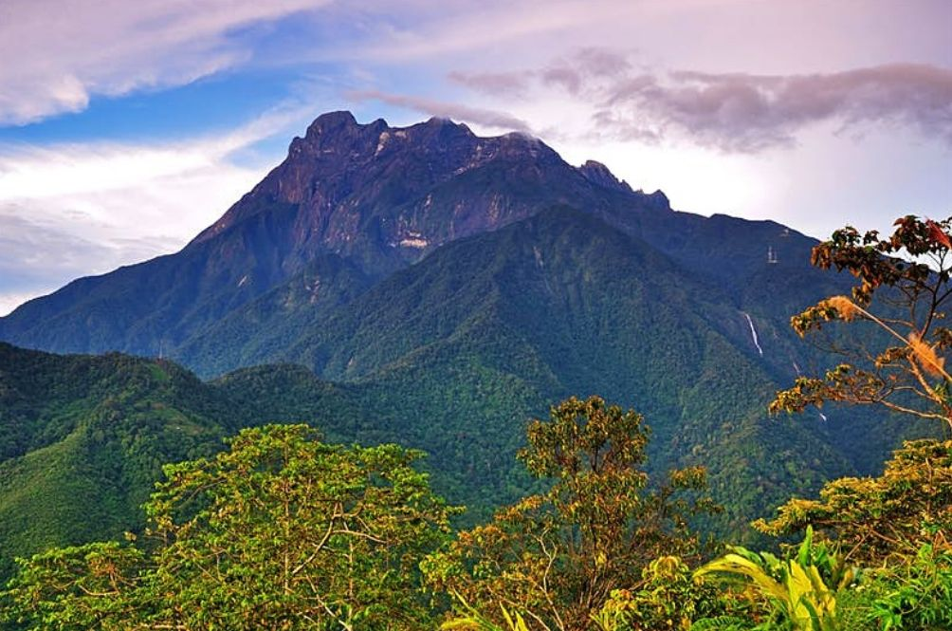
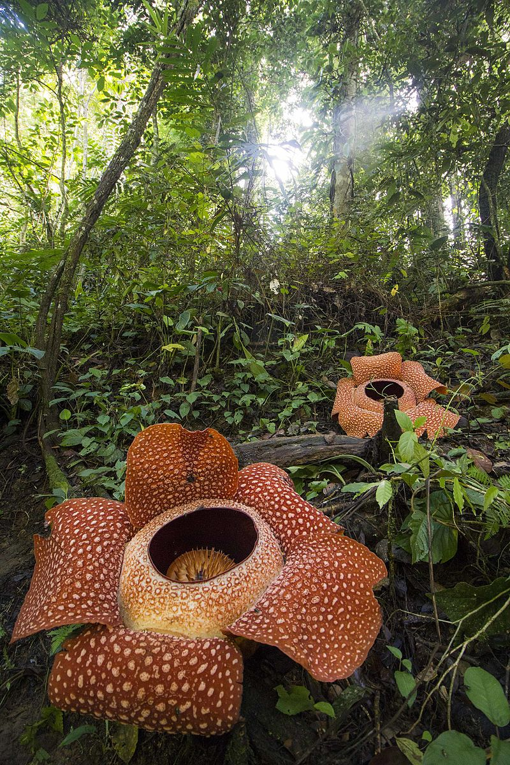
Highest Mountain in Malaysia
Mt. Kinabalu
Located in Sabah
Height 4,095m
Bunga Rafflesia

Slide 23
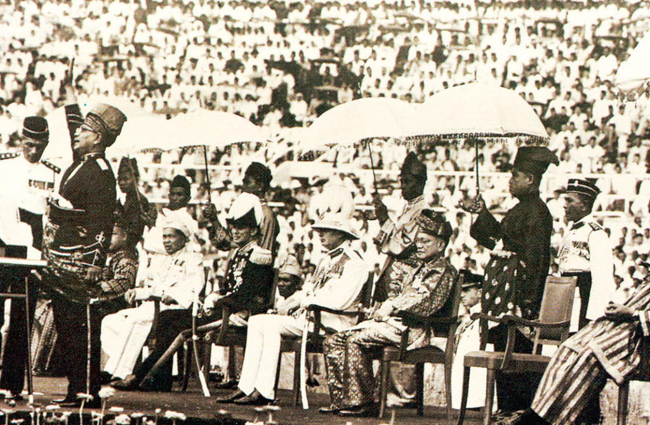
MALAYSIAN NATIONAL DAYS
Independence Day – 31 August
Malaysia Day – 16 September

Slide 24
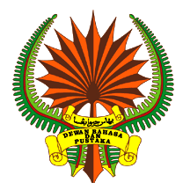
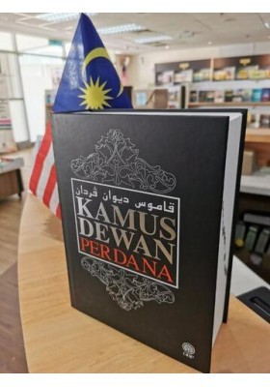
National Language
Malay is the National Language
Status confirmed in Article 152 of the Federal Constitution
Dewan Bahasa dan Pustaka (DBP), body responsible for coordination of use of Malay
Aside from standard Malay, there are also regional Malay dialects in:Kelantan, Terengganu, Johor, Kedah, Sarawak, Brunei

Slide 25
Languages aside from the National Language
Mother tongues:
Chinese (Mandarin and other dialects)
Indian (Tamil and other languages like Malayali, Telugu, Punjabi, etc.)
Languages of the Orang Asli
Sarawak Native lanbguages(Iban, Bidayuh etc)
Sabah native language (Dusun, etc)
Other minority languages (Siamese, Portuguese)
International languages: English, Japanese, Indonesian
BAHASA ROJAK, Malaysian English and MANGLISH

Slide 26
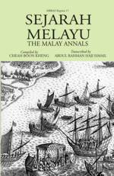

TRADITIONAL LITERATURE
Sejarah Melayu, or the Malay Annals.
Chronicles the rise and fall of the Malay Sultanate of Malacca
Hikayat Merong Mahawangsa
Chronicles the legendary origins of Kedah

Slide 27
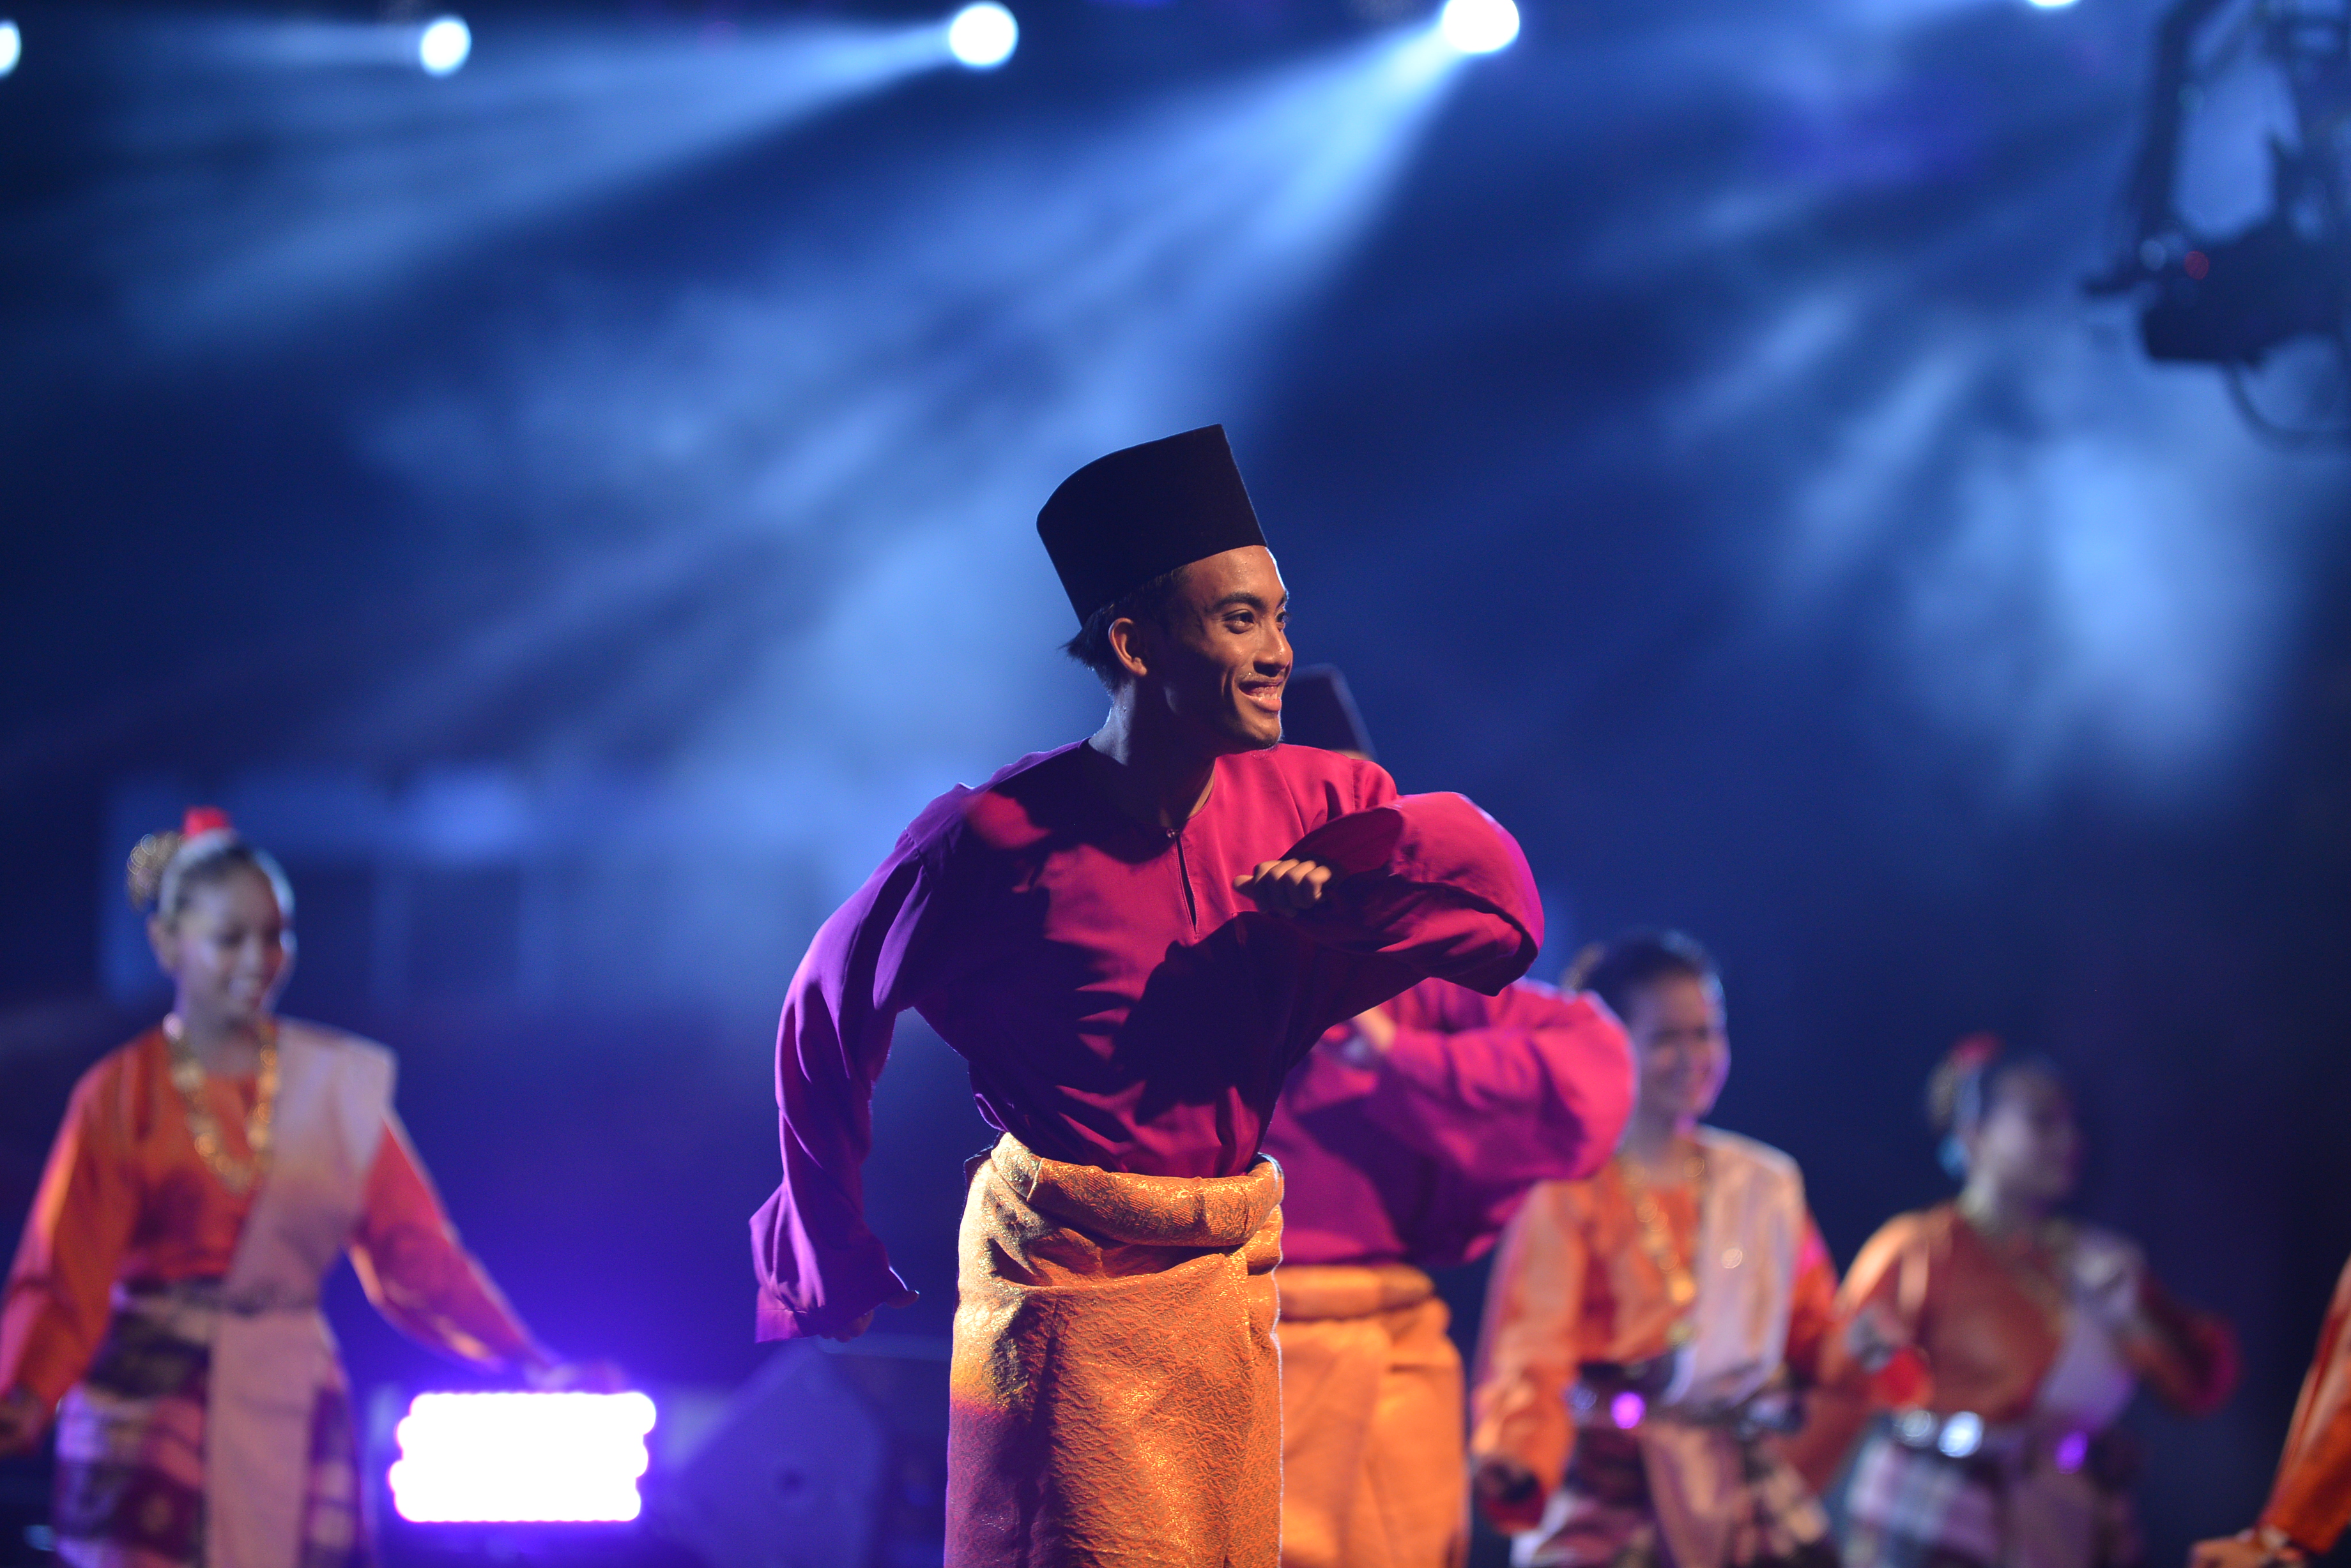
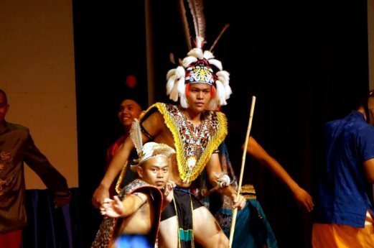
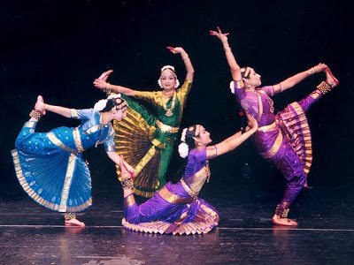
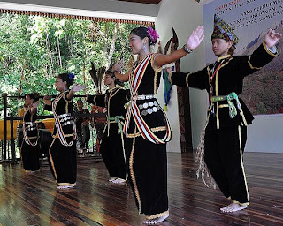
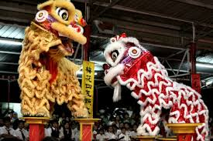
National Dance
Ngajat, one of the dances from Sarawak
Zapin, a Malay dance from Johor
Bharatanatyam, Indian dance
Sumazau, one of the Sabah dances
Chinese Lion Dance

Slide 28
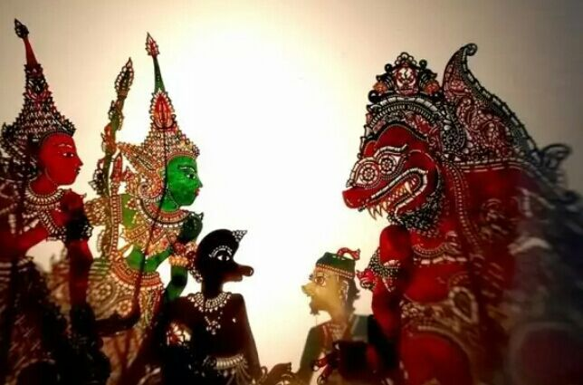
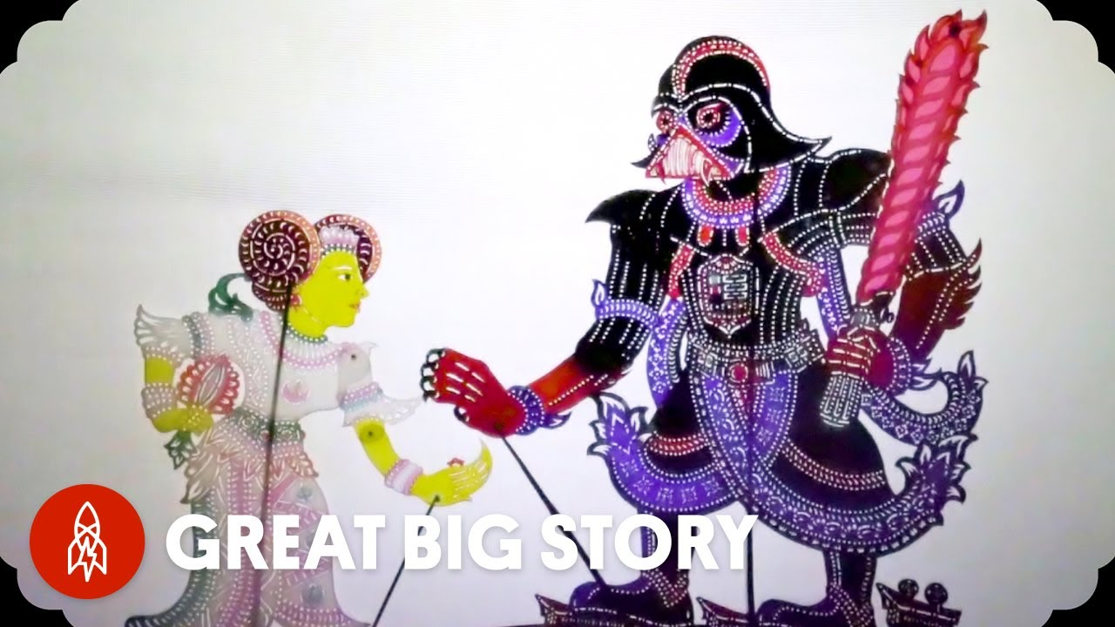
Malaysian Art: Wayang Kulit
Shadow puppet
Traditional performance art
Popular in Kelantan and Kedah
Stories based on episodes of the Ramayana
Accompanies by music
Video: https://www.youtube.com/watch?v=meF57TpAmOQ
Modern wayang kulit: Star Wars
Video: https://www.youtube.com/watch?v=7HGy2ncM010

Slide 29
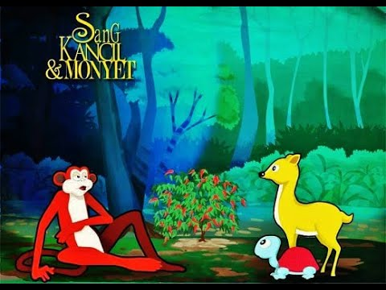
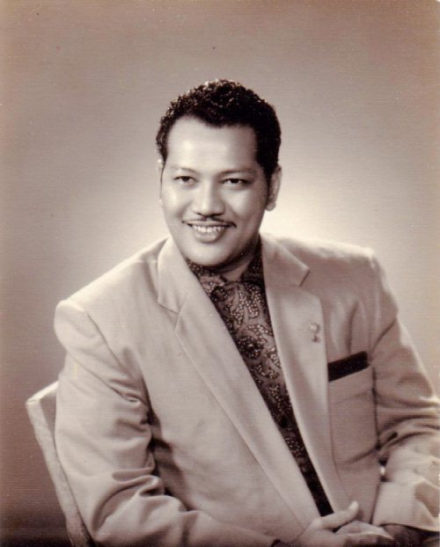
Malaysian Films
1947-1972: Golden Age of Malaysian Cinema
Tan Sri P. Ramlee (1929-1973), director, singer, songwriter, actor, legend
Hikayat Sang Kancil dan Monyet, first animated short produced by Malaysia (1982)
https://www.youtube.com/watch?v=EOt_NaXKi5o

Slide 30
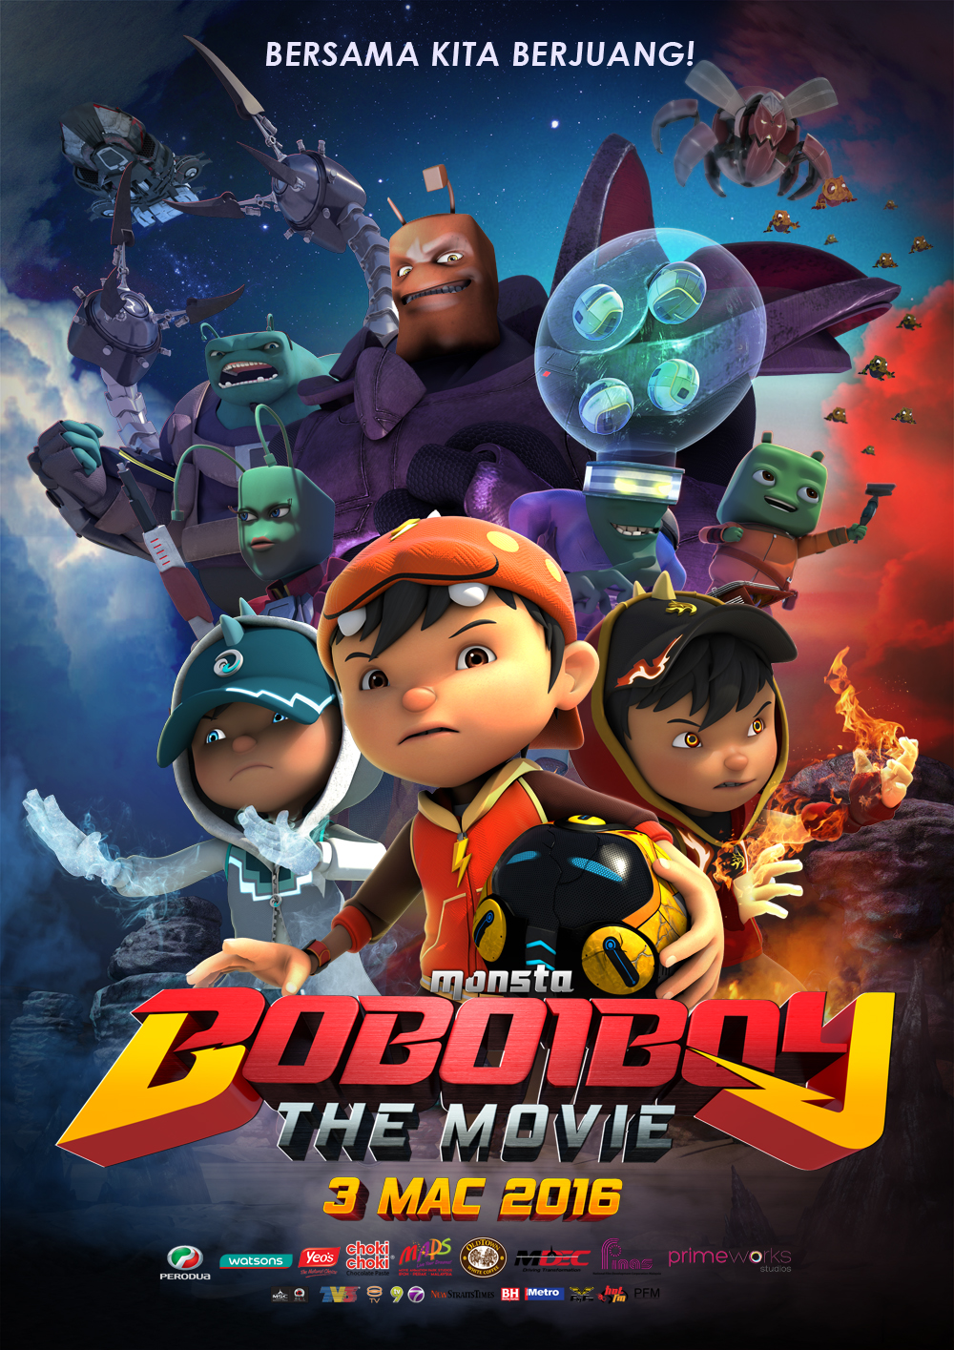

New developments in Malaysian animation:
Left: Boboiboy the Movie (2016)
Right: Upin & Ipin: Keris Siamang Tunggal (2019)

Slide 31
Be familiarize with some Malays’ terms and words
Malays = people = Melayu
Malay language = the national language of Malaysia
Malaysia = the country
Peninsular Malaysia = West Malaysia
Sabah and Sarawak = East Malaysia
Yang di-Pertuan Agong = The King (Head of the state/country – highest political position in Malaysia)
Sultan / Raja / Malay Rulers = the head/leader for states = the head of Islamic affair for states
Dato’ / Dato’ Seri / Tan Sri / Tun = some of the titles of the higher political position in Malaysia given by the King or Sultans

